Slide 1


Advanced Automation with RedHat Ansible

Slide 2
Agenda
AM (9:30am-12:30pm)
Overview of OpenShift & Ansible
Ansible Fundamentals
Exercise 1 – Ad-hoc
Exercise 2 – Ad-hoc
Lunch (1 hour)

Slide 3
Agenda
PM (1:30pm-5:30pm)
Playbook Basics
Exercise 3 - Playbook basic
Playbook Variables
Scaling Automation
Debugging & Performance Tuning
Exercise 4 - Ansible Playbook
Exercise 5 - Advanced Ansible

Slide 4
Session 1:
Overview of OpenShift & Ansible

Slide 5

What Is OpenShift?
OpenShift is an enterprise container platform built on top of Kubernetes.
It provides:
• Container orchestration • Automated application deployment • Scaling & self-healing • Built-in security controls • Hybrid & multi-cloud support

Slide 6
Kubernetes vs. OpenShift
Kubernetes provides:
Container scheduling
Service networking
Scaling
Self-healing
OpenShift adds:
Web management console (GUI)
Integrated container registry
Built-in CI/CD pipelines
Stronger security defaults (restricted containers)
Enterprise support from Red Hat

Slide 7

What Is Ansible?
Ansible is an agentless IT automation platform used for:
Configuration management
Application deployment
Infrastructure provisioning
Orchestration
We need Ansible to automate repetitive infrastructure tasks across many machines in a consistent and reliable way.

Slide 8
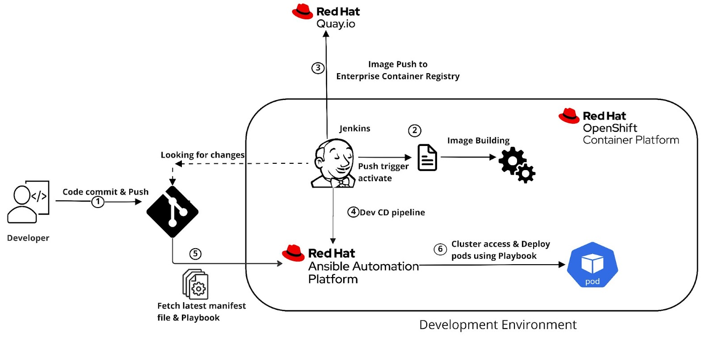
OpenShift with Ansible
Ansible provisions OpenShift clusters
Ansible deploys applications into OpenShift
Ansible manages configuration & updates
Used together in DevOps pipelines

Slide 9
Access the Environment
Login to your host host via SSH:
$ ssh <login name>
Check Ansible has been installed correctly:
$ ansible --version
You should see something like:
ansible [core 2.17.14]

Slide 10
Session 2:
Ansible Fundamentals

Slide 11
Core Components
Control Node
Machine where Ansible is installed
Executes automation tasks
Managed Nodes
Target systems being automated
No agent required
Communicate via SSH (Linux) or WinRM (Windows)

Slide 12
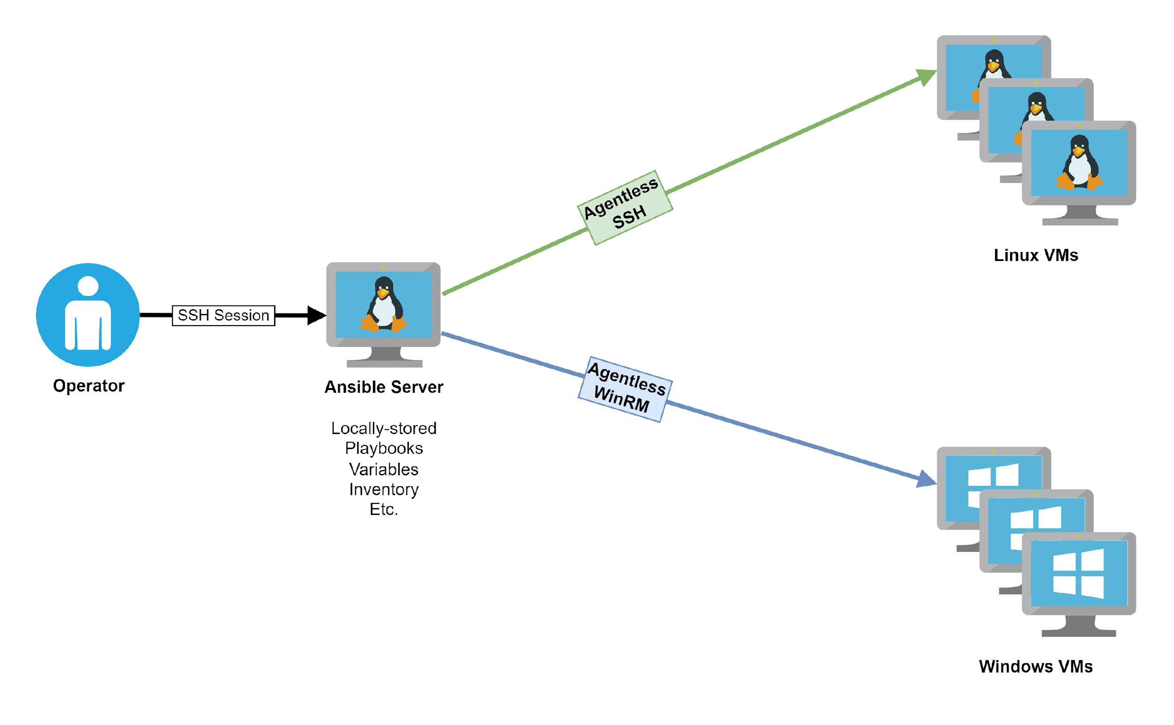
Core Components
Inventory
Inventory defines which machines Ansible manages. There are two types:
Static inventory (INI or YAML files)
Dynamic inventory (cloud plugins)
Inventory List

Slide 13
Core Components
Modules
reusable units of work
ensure idempotency
Examples:
package: install software
service: manage services
copy: copy files
template: deploy configuration files

Slide 14
Core Components
Idempotency
Running the same playbook multiple times produces the same final result without causing unintended changes.
Why important?
Safe re-runs
Infrastructure drift correction
CI/CD compatibility

Slide 15
Core Components
Playbooks
Playbooks are YAML files that define automation. It defines:
Target hosts
Tasks
Modules
Desired state
e.g.
- hosts: web
tasks:
- name: Install nginx
package:
name: nginx
state: present

Slide 16
Ad-Hoc commands
Ad-hoc commands are one-time, quick commands you run directly from the terminal — without writing a playbook. They are used for simple, immediate tasks. They follow the following pattern:
$ ansible <hosts> -m <module> -a "<arguments>"
-m module
-a argument

Slide 17
Inventory Query
Inventory query does NOT run any task. It simply shows which hosts belong to the group. It can be used to
verify your inventory
check if group name is correct
debug targeting before running real commands
Inventory List:
[web]
node1 ansible_host=192.168.55.201
node2 ansible_host=192.168.55.202
node3 ansible_host=192.168.55.203
$ ansible web --list-hosts
Host (3):
node1
node2
node3

Slide 18
Listing Modules
Ansible comes with a lot of modules by default. To list all modules, run:
$ ansible-doc -l
To find a module, run:
$ ansible-doc -l | grep -i <keyword>
To get help for a specific module including usage examples:
$ ansible-doc <module name>

Slide 19
Using Command Module
The command module executes a Linux command on managed hosts. It does NOT use a shell (safer, more predictable). It follows the following pattern:
$ ansible <host-pattern> -m command -a "<linux-command>”
e.g.
$ ansible localhost -m command -a "id"
Output shows uid, gid, groups and security context.
$ ansible all -m command -a "uname -r"
This check Kernel Version on All Hosts.

Slide 20
Using Copy Module
The copy module executes an ad-hoc command on host to change the contents of the file in destination.
e.g.
$ ansible localhost -m copy -a 'content="Managed by Ansible\n" dest=/tmp/testfile'
You can verify the changes by
$ ansible localhost -m command -a "cat /tmp/testfile"

Slide 21
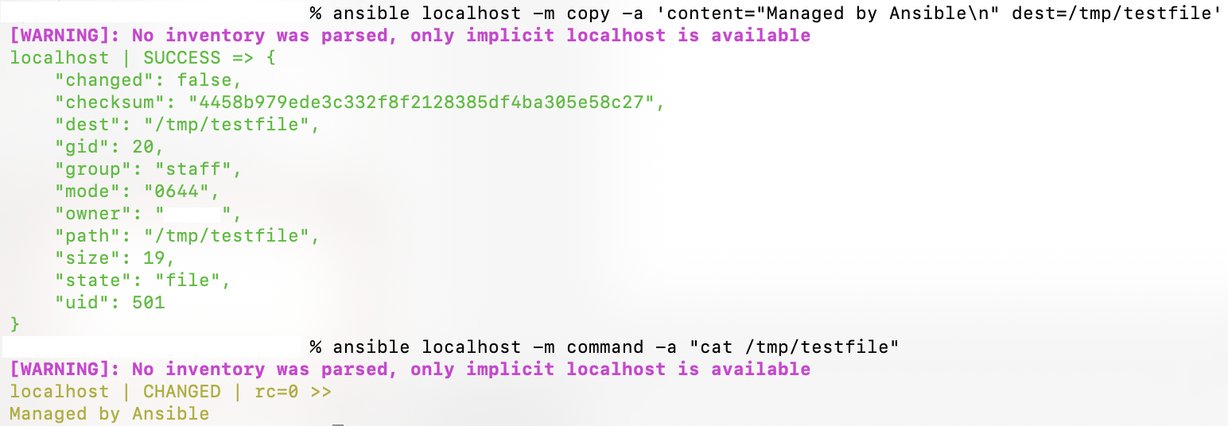

Slide 22
Exercise #1 – Using Ad-hoc

Slide 23
Exercise #1 – Using Ad-hoc
Using ansible-doc
Find a module that uses Yum to manage software packages.
Look up the help examples for the module to learn how to install a package in the latest version.
Run an Ansible ad hoc command to install the package “squid” in the latest version on localhost.

Slide 24
Exercise #2 – Using Ad-hoc

Slide 25
Exercise #2 – Using Ad-hoc
Using Ansible ad-hoc commands only, perform the following on localhost:
Discover the correct package module for your OS (yum / dnf / apt).
Install a web server package (latest version) (httpd / apache2).
Ensure the service is started and enabled at boot (use service command)
Hints:
Use ansible-doc -l
You may need -c local

Slide 26
Exercise #2 – Using Ad-hoc
After setup:
Verify the service is running.
Re-run your commands.
Think:
Why first run shows CHANGED
Why second run shows SUCCESS
What breaks if you remove -b
What happens if you choose the wrong module

Slide 27
Lunch time (1 hour)

Slide 28
Session 3:
Playbook Basics

Slide 29
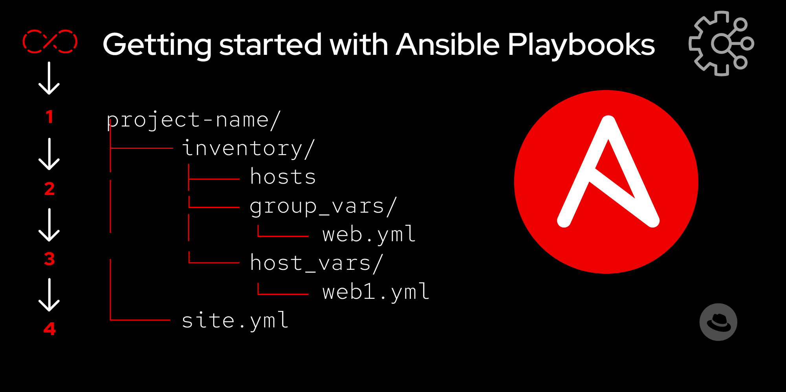
What Is a Playbook
Playbook in Ansible:
Text files written in YAML format
Define automation workflows
Describe the desired state of systems
Playbooks are declarative — they describe what should be, not how to do it.

Slide 30
YAML Requirements
Playbooks must:
Start with three dashes
Use proper indentation
Use spaces, not tabs
Maintain consistent structure
YAML is whitespace-sensitive — indentation errors cause failures.

Slide 31
Basic Playbook Structure
A playbook is a list of plays. It has the following structure:
---
- name: Play name
hosts: target_hosts
become: true/false
vars:
variable_name: value
tasks:
- name: Task name
module_name:
option1: value
option2: value

Slide 32
Key Playbook Components
hosts
Target machines to run tasks on
tasks
List of operations
Call Ansible modules
Define desired state

Slide 33
Key Playbook Components
become
Enables privilege escalation
Equivalent to using -b in ad hoc commands
Used for administrative tasks
gather_facts
Collect system info before running tasks (default true)

Slide 34
Execution Order
In Ansible playbook, ordering is important. Automation is sequential and deterministic. Ansible executes:
Plays in order
Tasks in the order written
Incorrect ordering can cause:
Dependency failures
Service startup issues
Configuration errors

Slide 35
Idempotency
A good Playbook must be idempotent. If run once, hosts reach desired state. If run again, no further changes should occur. This ensures:
Safe re-execution
Predictable results
Production stability

Slide 36
Idempotency
Most Ansible modules are already idempotent. They:
Check current system state
Compare against desired state
Change only if necessary

Slide 37
Playbook Example
The following minimal playbook will print the message “Hello World”.
---
- hosts: localhost
gather_facts: false
tasks:
- name: Print Hello World
debug:
msg: "Hello, World!"

Slide 38
Running Playbook
Ansible Playbooks are executed using the ansible-playbook command on the control node. You can check for syntax errors using:
$ ansible-playbook --syntax-check <playbook file name>
Now you should be ready to run your playbook:
$ ansible-playbook <playbook file name>

Slide 39
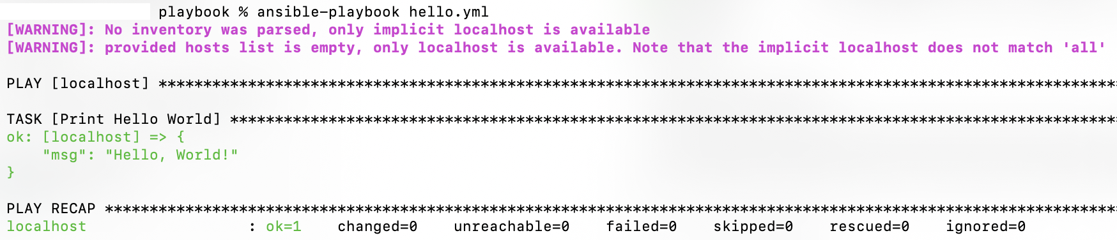
First Playbook Example

Slide 40
Playbook Extension
---
- name: Simple Web Setup
hosts: localhost
become: true
tasks:
- name: Install nginx
package:
name: nginx
state: present
- name: Start nginx
service:
name: nginx
state: started
- name: Print completion message
debug:
msg: "Web server setup complete"
A playbook can contain multiple tasks. You can extend it by adding more tasks under the tasks section.
As Ansible executes tasks from top to bottom, you should make sure that the tasks are written in correct order.

Slide 41
Multiple Host
---
- name: Simple Web Setup
hosts: web
become: true
tasks:
- name: Install nginx
package:
name: nginx
state: present
- name: Start nginx
service:
name: nginx
state: started
- name: Print completion message
debug:
msg: "Web server setup complete"
In Ansible, the same set of tasks can be applied reliably to many hosts.
e.g.
Inventory List:
[web]
node1 ansible_host=192.168.55.201
node2 ansible_host=192.168.55.202
node3 ansible_host=192.168.55.203

Slide 42
Exercise #3 – Playbook Basics

Slide 43
Session 4:
Playbook Variables

Slide 44
Intro to Variables
Variables store values for use in Playbooks. They are referenced using double curly braces. They make playbooks dynamic, avoid hardcoding values and enable multi-environment automation. Variables can be defined in:
Inventory files
host_vars / group_vars
Command line
External files

Slide 45
Intro to Variables
They can be used as following:
- name: Deploy app config template: src: app.conf.j2 dest: /etc/myapp/config.conf | port = {{ app_port }} name = {{ app_name }}
deploy.yml | app.conf.j2

Slide 46
Host & Group Variables
group_vars
Defined for a group of hosts
Stored in group_vars/<groupname>.yml
Applies to all hosts in the group unless overridden by host vars
host_vars
Defined for a single host
Stored in host_vars/<hostname>.yml
Overrides group variables for that host

Slide 47
Host & Group Variables
Inventory List
[web]
web1 ansible_host=192.168.1.10
web2 ansible_host=192.168.1.11
group_vars/web.yml
app_port: 8080
app_name: demoapp
host_vars/web1.yml
app_port: 8081
Playbook
- hosts: web
gather_facts: false
tasks:
- debug:
msg: "Deploying {{ app_name }} on port {{ app_port }}"
Output
web1: port 8081
web2: port 8080

Slide 48
Session 5:
Scaling Automation

Slide 49
Why Scale Automation?
While it is possible to write a playbook in one, eventually it is better to reuse files and start to organize things.
Large playbooks become hard to read and maintain
Repeated tasks across multiple projects
Need to organize automation for teams
Solution:
Use Roles and Collections to structure, reuse, and share automation.

Slide 50
Roles
roles
└── apache_vhost
├── defaults
│ └── main.yml
├── files
├── handlers
│ └── main.yml
├── meta
│ └── main.yml
├── README.md
├── tasks
│ └── main.yml
├── templates
├── tests
│ ├── inventory
│ └── test.yml
└── vars
└── main.yml
Roles are a way to organize tasks, variables, templates, files, and handlers into reusable components.
It follows a defined directory structure; a role is named by the top level directory. Some of the subdirectories contain YAML files, named main.yml. The files and templates subdirectories can contain objects referenced by the YAML files.

Slide 51
Roles
roles
└── apache_vhost
├── defaults
│ └── main.yml
├── files
├── handlers
│ └── main.yml
├── meta
│ └── main.yml
├── README.md
├── tasks
│ └── main.yml
├── templates
├── tests
│ ├── inventory
│ └── test.yml
└── vars
└── main.yml
The various main.yml files contain content depending on their location in the structure. Note that the main.yml files only contain the specific content and no additional playbook information.
Default variables have the lowest precedence and usually contain default values. Variables can be set in either vars/main.yml or defaults/main.yml, but not in both places.

Slide 52
Using Roles in Playbooks
To use roles in playbooks can automatically loads tasks, handlers, templates, variables, and defaults from the role, which keeps playbooks clean and concise
e.g.
---
- hosts: web
become: true
roles:
- webserver

Slide 53
What Are Collection?
Collections are packaged Ansible content including roles, modules, plugins, and playbooks that can be shared or installed from Ansible Galaxy.
It allows:
Sharing automation across teams and projects
Including community or vendor-provided content
Managing multiple related automation artifacts together

Slide 54
Creating a Role Directory Structure
To build a role, we can use
$ mkdir roles
$ ansible-galaxy init --offline roles/apache_vhost
Then we can look at the structure using
$ tree roles

Slide 55
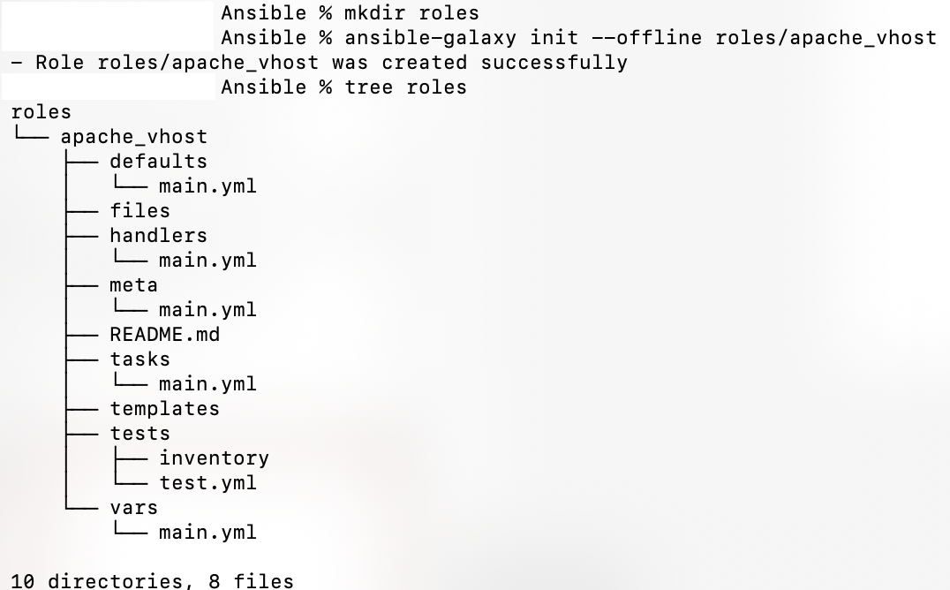

Slide 56
Session 6:
Debugging & Performance Tuning

Slide 57
Large playbooks or roles may fail silently
Automation may be slow or inefficient
Early detection of errors saves time in production
Goals:
Quickly identify and fix errors
Optimize playbook execution
Ensure reliable automation

Slide 58
Debugging Techniques
Using debug Module: prints variables or messages
- name: Show variable value
debug:
var: my_variable
Using ansible-playbook --check: shows what would change without actually modifying hosts

Slide 59
Debugging Techniques
Using block/rescue/always
tasks:
- block:
- name: Deploy backend
command: /opt/deploy.sh
rescue:
- name: Rollback backend
command: /opt/rollback.sh
always:
- name: Cleanup temp files
file:
path: /tmp/tmpfile
state: absent

Slide 60
Performance Tuning
Limit hosts with –limit
ansible-playbook site.yml --limit web1
Use fact caching to avoid repeated gather_facts
[defaults]
gathering = smart
fact_caching = jsonfile
fact_caching_connection = /tmp/facts

Slide 61
Exercise #4 – Ansible Playbook

Slide 62
Exercise #5 – Advanced Ansible

Slide 63
Evaluation time
Thank you!

